Slide 1

DBMS LAB 5
SQL SUB QUERIES

Slide 2
What is a Sub Query?
A subquery is a SQL query nested inside a larger query.
A subquery may occur in :
- A SELECT clause
- A FROM clause
- A WHERE clause
A subquery is also called an inner query or inner select, while the statement containing a subquery is also called an outer query or outer select.
The inner query executes first before its parent query so that the results of an inner query can be passed to the outer query.

Slide 3
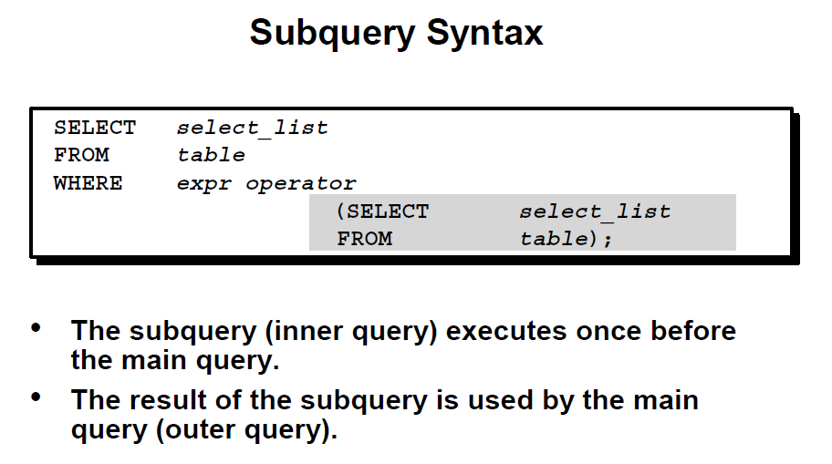
Sub query Syntax

Slide 4
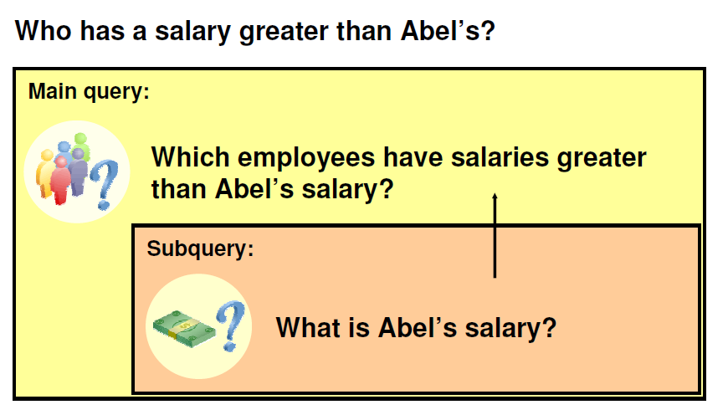
USING SUBQUERIES TO SOLVE A PROBLEM

Slide 5
Using a Subquery to Solve a Problem
Suppose you want to write a query to find out who earns a salary greater than Abel’s salary.
To solve this problem, you need two queries: one to find how much Abel earns, and a second query to find who earns more than that amount.
You can solve this problem by combining the two queries, placing one query inside the other query.
The inner query (or subquery) returns a value that is used by the outer query (or main query). Using a subquery is equivalent to performing two sequential queries and using the result of the first query as the search value in the second query.

Slide 6
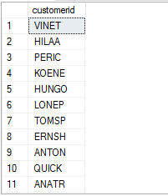
Subquery Example
Exercise: Find all customers who have ordered products having unitprice of 14.
Select customerid from Orders where OrderID in(select OrderID from orderdetails where UnitPrice=14 )

Slide 7
Using a Subquery
A subquery is a SELECT statement that is embedded in a clause of another SELECT statement. You can build powerful statements out of simple ones by using subqueries. They can be very useful when you need to select rows from a table with a condition that depends on the data in the table itself.
The subquery is often referred to as a nested SELECT, sub-SELECT, or inner SELECT statement. The subquery generally executes first, and its output is used to complete the query condition for the main (or outer) query.

Slide 8
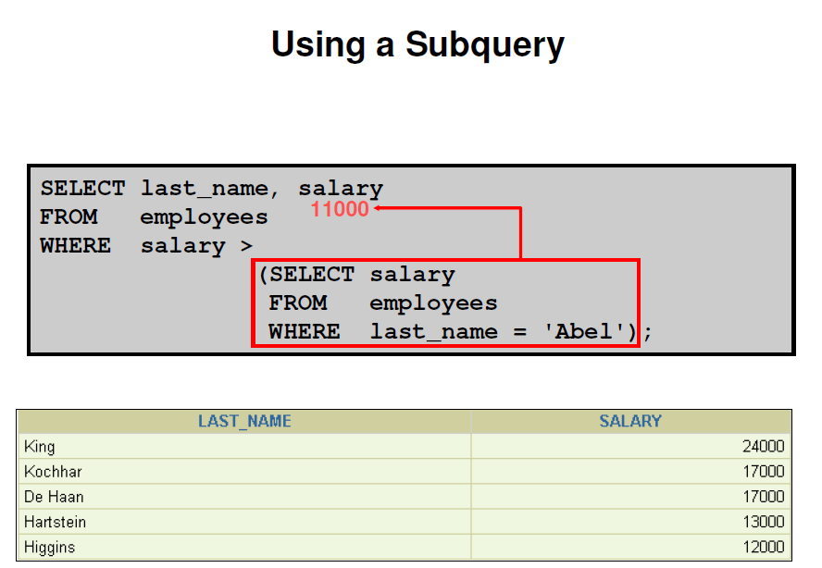
Sub query Example

Slide 9
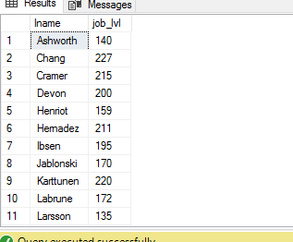
Sub Query Example
Q: Find all employees lastname whose job level is greater than Brown?
Select lname,job_lvl from employee where job_lvl> ( select job_lvl from employee where lname='brown')

Slide 10
Guidelines for using subqueries
Enclose subqueries in parentheses.
Place subqueries on the right side of the comparison condition.
Use single-row operators with single-row subqueries, and use multiple-row operators with multiple-row subqueries.

Slide 11
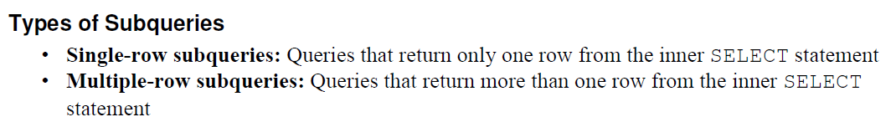
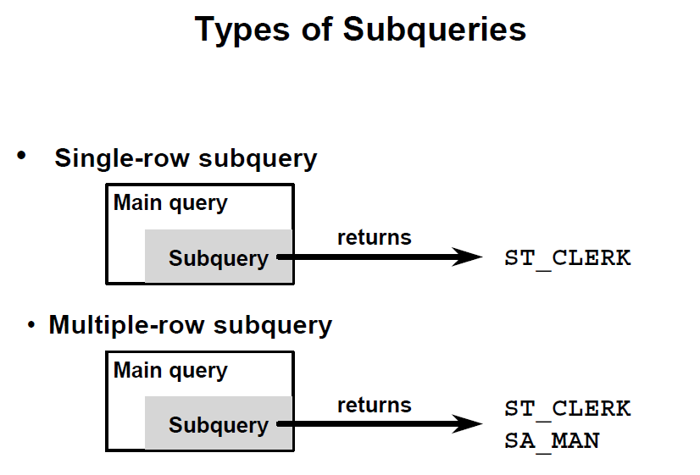
Types of Subqueries

Slide 12
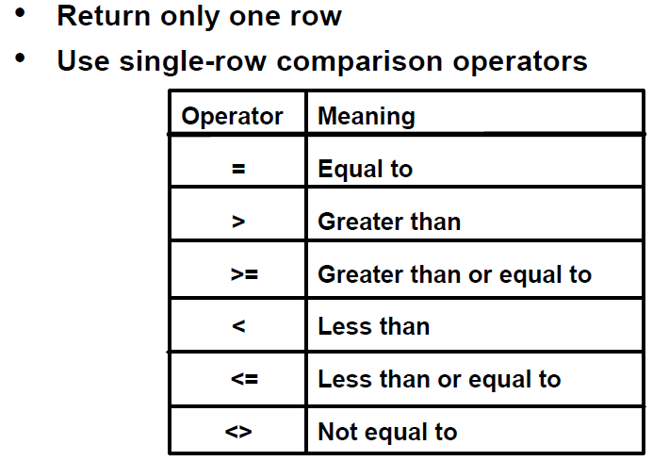
Single – Row Subqueries

Slide 13
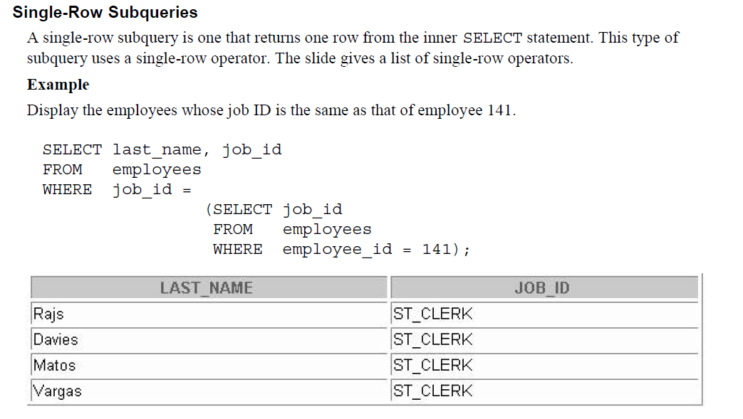
Single – Row Subqueries

Slide 14
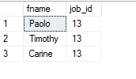
Example:
Q: Display all employees whose job id is the same as of employee PMA42628M. Use Pubs.
Select fname,job_id from employee where job_id= (select job_id from employee where emp_id='PMA42628M')

Slide 15
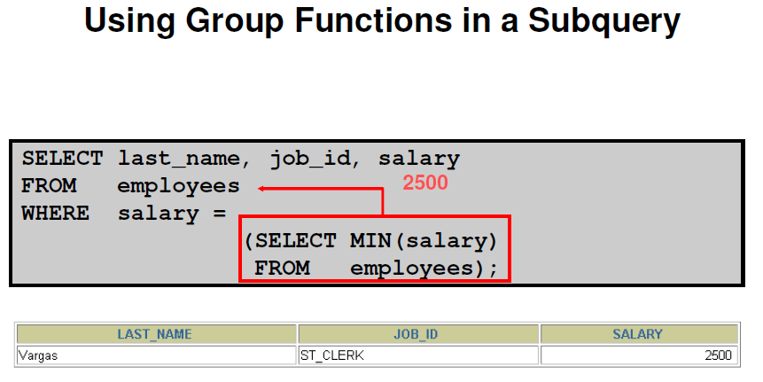
Using Aggregate function in Subquery

Slide 16

Example:
Q: Display all employees who have got min job level. Use Pubs.
select fname,job_id, job_lvl from employee where job_lvl= ( select min(job_lvl) from employee)

Slide 17
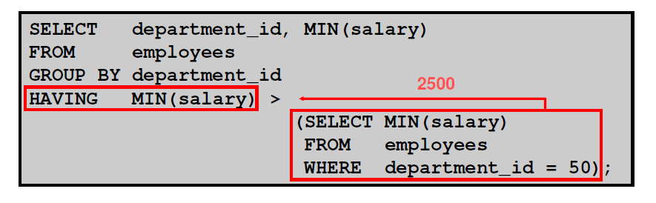
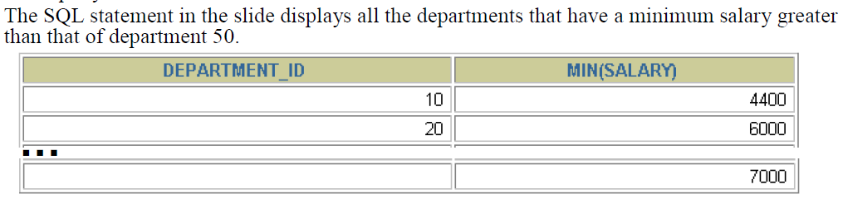
The HAVING Clause with Subqueries

Slide 18
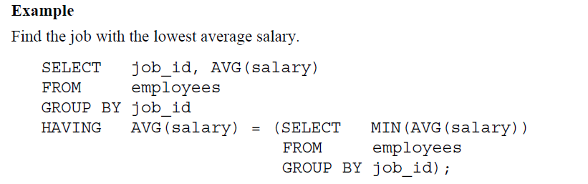
The HAVING Clause with Subqueries

Slide 19
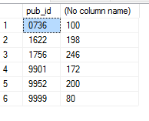
Example
Q: Display all publishers that have minimum joblevel greater than that of publisher 0877. Use pubs.
Select pub_id,min(job_lvl) from employee group by pub_id having min(job_lvl)> (select min(job_lvl) from employee where pub_id=0877)

Slide 20
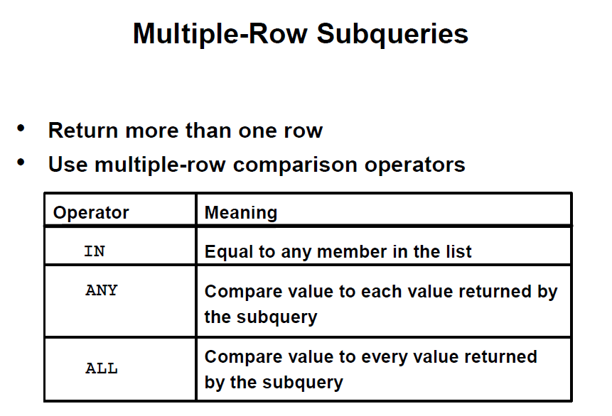
Multiple Row Subqueries

Slide 21
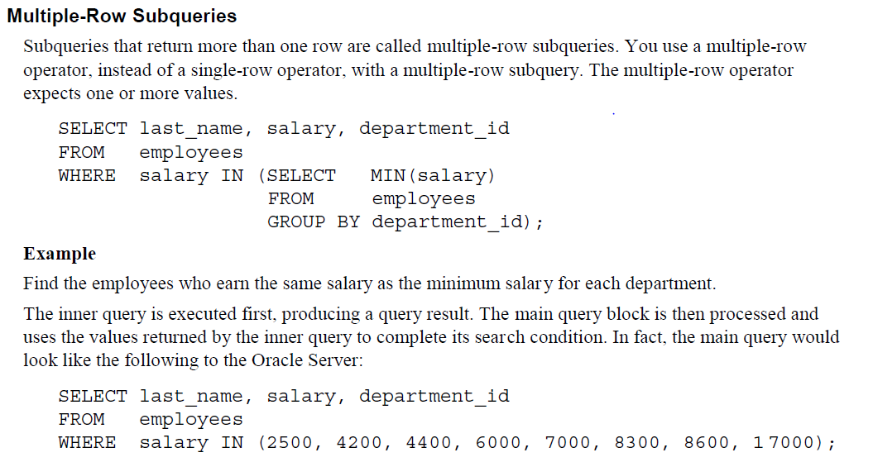

Slide 22
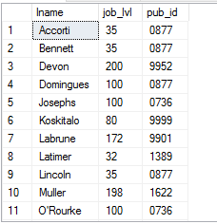
Example
Q: Display all employees who has the same job level as the minimum job level of each publisher. Use pubs.
Select lname,job_lvl,pub_id from employee where job_lvl in ( select min(job_lvl) as Minimumjoblevel from employee group by pub_id);

Slide 23
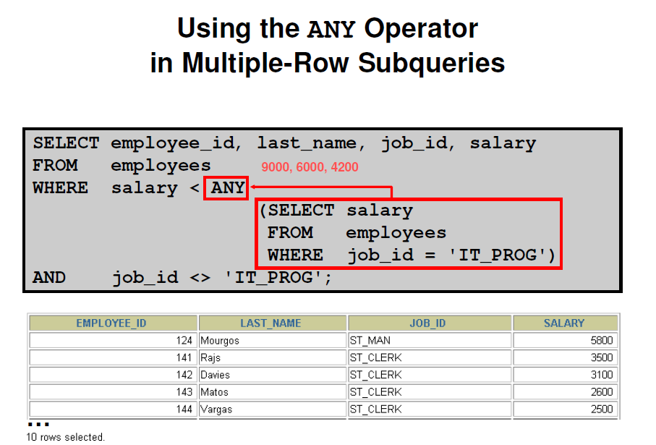
Multiple – Row Subqueries
Using the ANY Operator in Multiple – Row Subqueries
The slide example displays employees who are not IT programmers and whose salary is less than that of any IT programmer. The maximum salary that a programmer earns is $9,000.

Slide 24
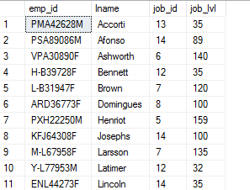
Example
Q: Display all employees whose job level is less than that of any of the job id 10 and whose job id is not equal to 10.
Select emp_id,lname,job_id,job_lvl from employee where job_lvl<Any ( select job_lvl from employee where job_id=10) and job_id<>10;

Slide 25
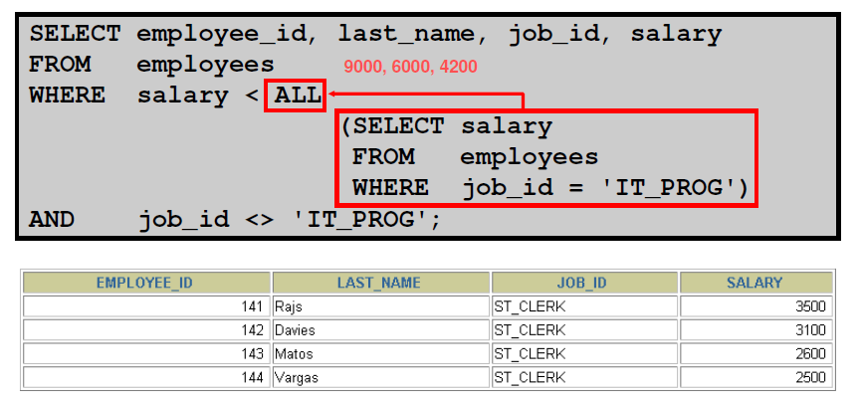
Multiple – Row Subqueries
Using the ALL Operator in Multiple – Row Subqueries
Multiple-Row Subqueries (continued)
The ALL operator compares a value to every value returned by a subquery. The slide example displays employees whose salary is less than the salary of all employees with a job ID of IT_PROG and whose job is not IT_PROG.

Slide 26
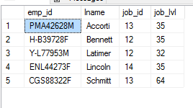
Example
Q: Display all employees whose job id is not equal to 10 and whose job level is less than that of all employees having job id =10.
Select emp_id,lname,job_id,job_lvl from employee where job_lvl< All ( select job_lvl from employee where job_id=10) and job_id<>10;

Slide 27


Example
To list all Northwind customers who have not placed an order.
Using Join :
Select o.orderid, c.customerID, c.contactName
from orders o
full outer join Customers c on o.customerID = c.customerid
where o.OrderID is NULL
Using Subquery:
Select * from Customers
where CustomerID Not in (Select CustomerID from orders)

Slide 28
Example
We wanted to know the ProductIDs of every item sold on the first day any product was purchased from the system. If you already know the first day that an order was placed in the system, then it’s no problem; the query would look something like this:
SELECT DISTINCT o.OrderDate, od.ProductID
FROM Orders o
JOIN [Order Details] od
ON o.OrderID = od.OrderID
WHERE OrderDate = ‘7/4/1996’ --This is first OrderDate in the system

Slide 29
Result

Slide 30
EXAMPLE
Using “Sub Query” it will be done as follows
SELECT DISTINCT o.OrderDate, od.ProductID
FROM Orders o
JOIN [Order Details] od
ON o.OrderID = od.OrderID
WHERE o.OrderDate = ( SELECT MIN(OrderDate) FROM Orders)

Slide 31
TASKS
Find the company’s name that placed order 10290. (Tables : Customers & Orders)
Find the Companies that placed orders in 1997 (Tables : Customers & Orders)
Create a report that shows the product name and supplier id for all products supplied by Exotic Liquids, Grandma Kelly's Homestead, and Tokyo Traders. (Tables : Products & Suppliers)
HINT: You will need to escape the apostrophe in "Grandma Kelly's Homestead." To do so, place another apostrophe in front of it. For example,
SELECT * FROM Suppliers WHERE CompanyName='Grandma Kelly‘’s Homestead’;
4. Create a report that shows all products by name that are in the Seafood category. (Tables : Products & Categories)
5. Create a report that shows all companies by name that sell products in CategoryID 8. (Tables : Supplier & Products)
6. Create a report that shows all 5companies by name that sell products in the Seafood category.(Tables: Suppliers, Products & Categories)

Slide 32
TASKS
7. Write query using a “sub query” to display which Customers were served by which Employee use Northwind
8. Write query using a “sub query” to list of all the stores that have discount records use pubs
9. Write query using a “sub query” to name publishers have got titles in store in Seattle? Use pubs
10. Write query using a “sub query” to list all the authors available in Barnum’s store use pubs
11. Write query using a “sub query” to give the customer id and amount spent of the customer who spent the most using Northwind
12. Write query using a “sub query” to list all Northwind customers who have not placed an order.

